Slide 1


Minor Project
Title: A Comparative Study and Analysis of Different Optimized Indexing Algorithms
Presented by:
R2142211229 - Anvi Goel
R2142211202 - Ayan Sar
Mentored By: Dr. Kingshuk Srivastava

Slide 2
Content
Introduction
Literature Review
Objectives
Methodology
Working Model
References
Colour Code:
Synopsis: Red
Mid term: Orange
End Term: Purple
Note: The Following presentation will have all the content of the later.

Slide 3
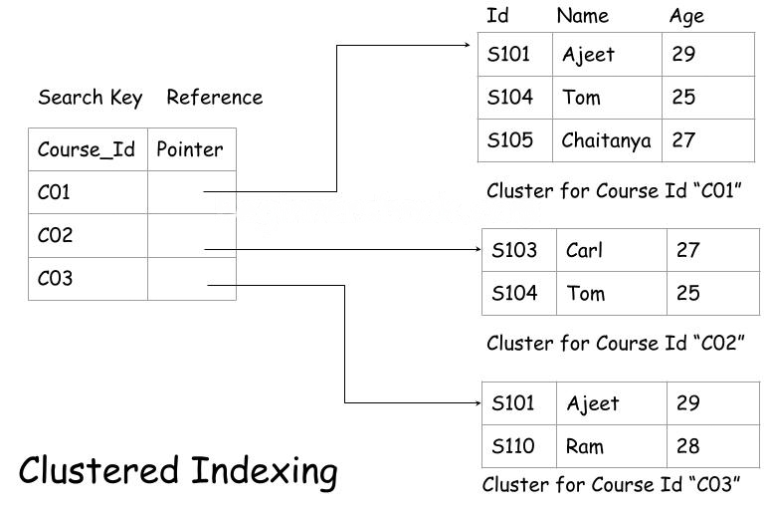
Introduction
Technical background of the project:
Indexing in Database systems: Databases contain large volumes of data that require indexing for easy and efficient data retrieval.
Types of Indexing algorithms: Many indexing algorithms like B-tree, B+ trees, hash indexes, bitmap indexes, etc. are available for efficient information retrieval systems.
Need for optimization: As databases grow in size, indexing algorithms’ performance becomes increasingly important.
Optimization techniques: These indexing algorithms can be optimized in various ways like AVL Tree, Caching, Batch processing, StringBuilder, and Thread pooling to improve their performance.
Basic Indexing in DBMS

Slide 4
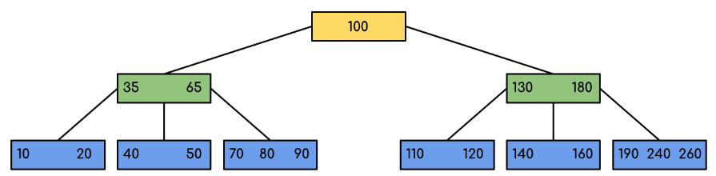
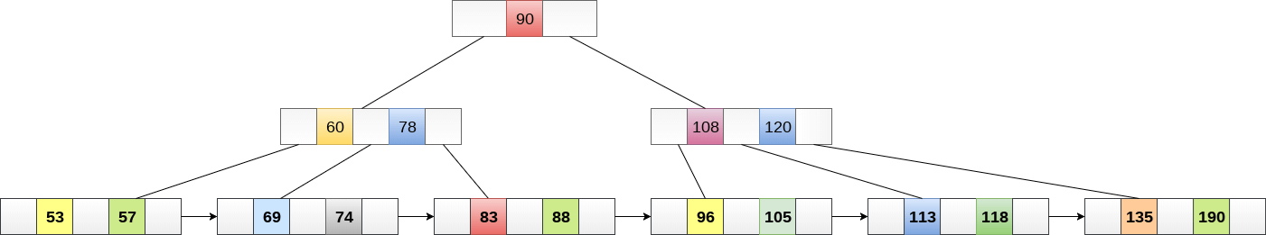
Introduction
Technical Concepts (Algorithms) used:
B-tree: Traditionally balanced tree structure used in many relational databases.
B+ tree: A Variant of B-tree, often preferred for disk-based storage due to its efficient data retrieval.
B-Tree
B+ Tree

Slide 5
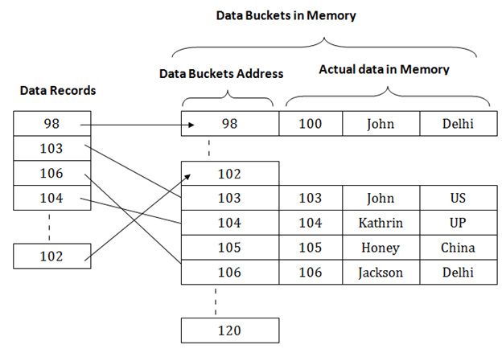
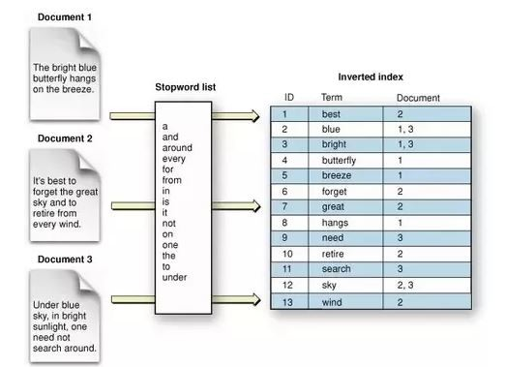
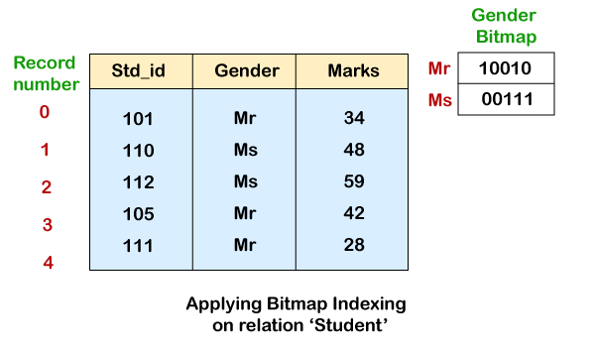
Introduction
Technical Concepts (Algorithms) used:
Hash index: Uses hash function to directly map keys to locations in a data structure, suitable for exact-match queries.
Bitmap index: Uses bitmaps to represent the presence or absence of values for specific attributes.
Inverted Index: Commonly used in full-text search engines, mapping terms to its documents.
Hash Indexing
Inverted Indexing

Slide 6
Introduction
Motivation:
Aims for improvement of system performance and reduction of resource consumption.
Also cut the costs for resource acquisition.
Improves scalability and manages ever-expanding datasets.
Problem Statement:
In this era of expanding the size of data, and especially in the sector of structured data, data retrieval time has become a major area of research.
The problem statement delves around this area and this project aims to compare and analyze the performance of various optimized indexing algorithms to determine their suitability for different data access and applications.
Area of Application:
Optimized indexing algorithms, impacting the speed of data retrieval, can be crucial in applications involving financial transactions, customer data management, e-commerce, healthcare records, etc.
Efficient indexing can also be beneficial in product search, recommendation systems, etc.
Dataset and input format:
Various datasets like Synthetic, and Real-World including CSV files, JSON files, and SQL Databases.

Slide 7
Literature Review
Inference from Literature:
A diverse range of optimized indexing algorithms were explored, along with their strengths and applications. B-tree and its variants, as discussed in [1], offer balanced structures with the B+-tree proving efficient for range queries and updates [2]. Bitmap indexing, as outlined in [3] and [4], provides an effective solution for high-dimensional data, with a focus on space efficiency. Spatial data indexing is addressed through R-trees and their variants, including the R*-tree. Which reduces overlap among nodes [5] and [6]. Hash indexing, as studied in [7] showcases constant-time lookup benefits but necessitates careful consideration of hash functions and collision resolution strategies. Trie-based indexing, as exemplified by [8], suits dictionary-like data and may benefit from compression techniques. LSM trees, such as the LevelDB LSM tree proposed by [9], offer an alternative to traditional B-trees for write-intensive workloads. Finally. From [10], it introduces the concept of learned index structures, harnessing machine learning for adaptive indexing, and challenging established methods with data-driven optimizations.

Slide 8
Objective
Main Objective:
Systematically evaluate and compare various indexing algorithms to identify performance characteristics, strengths, and weaknesses.
Finding the suitability for different applications and data access patterns.
Sub Objective:
Conducting a thorough assessment of various indexing algorithms.
Measuring query response times, insertion and deleting speeds, and scalability.
Determining the suitability of these algorithms for specific application scenarios, benchmarking their performance.
Investigating the various optimization techniques.
Recommendations for the selection and optimization of algorithms practically.

Slide 9
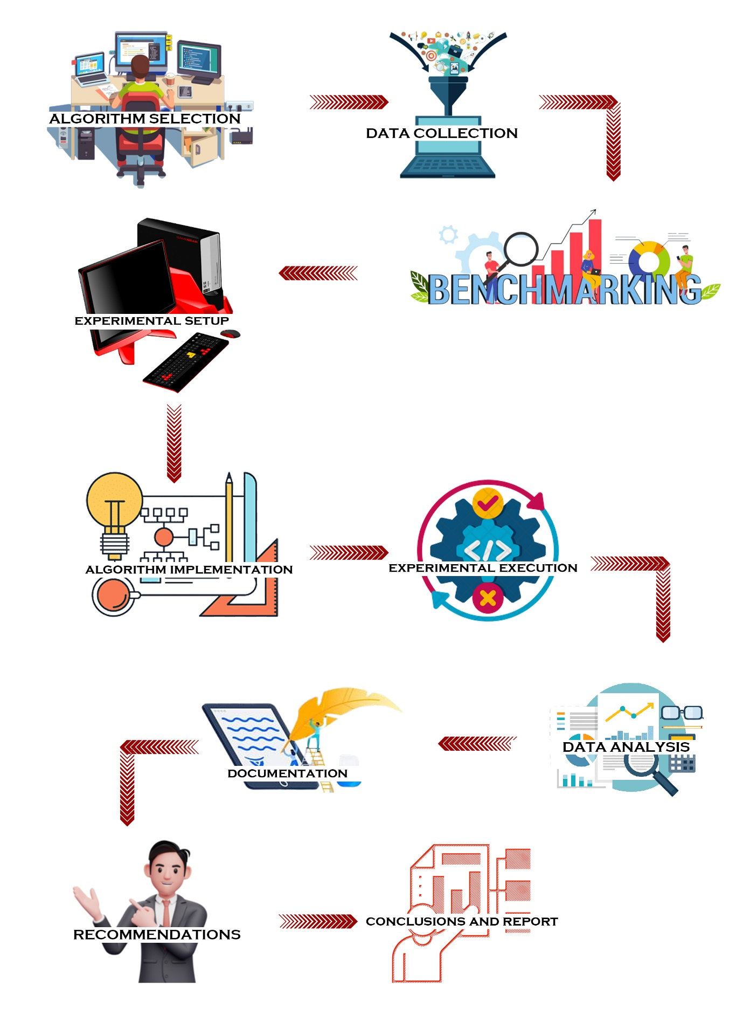
Methodology
Reference Software model:

Slide 10
Methodology
Steps:
Algorithm Selection: Select a diverse set of indexing algorithms that represent various optimization techniques in the field.
Data Collection: Gather a range of datasets, including structured, semi-structured, and unstructured data, to evaluate algorithm performance under different data types and sizes.
Benchmarking Criteria: Define a set of benchmarking criteria, including query response time, insertion and deletion efficiency, storage overhead, scalability, query pattern sensitivity, and concurrency handling.
Experimental Setup: Establish a controlled experimental environment with consistent hardware, software, and query workloads to ensure reproducibility.
Algorithm Implementation: Implement each selected indexing algorithm following best practices, ensuring optimization and efficiency.
Experiment Execution: Execute experiments with each algorithm, measure performance metrics across multiple trials, and record results.
Data Analysis: Analyze collected data statistically to assess algorithm performance, considering trade-offs and limitations.
Documentation: Document experimental setup, data sources, and detailed results, using visualizations to represent performance metrics effectively.
Recommendations: Provide recommendations and guidelines for selecting indexing algorithms based on the analysis, considering dataset types and real-world applications.

Slide 11
Methodology
Timeline:
Methodological steps | Time required
Algorithm selection | 1-2 days
Data Collection | 2-3 days
Benchmarking Criteria | 2 days
Experimental Setup | 1 day
Algorithm implementation | 2-3 days
Experiment Execution | 2 days
Data Analysis | 2 days
Documentation | 2 days
Recommendations | 1 day

Slide 12
Working Model
Requirement analysis (Link of SRS)
https://drive.google.com/file/d/178gYR8iBX7laRtC49K6hxnCpk0DhvSkK/view?usp=sharing

Slide 13
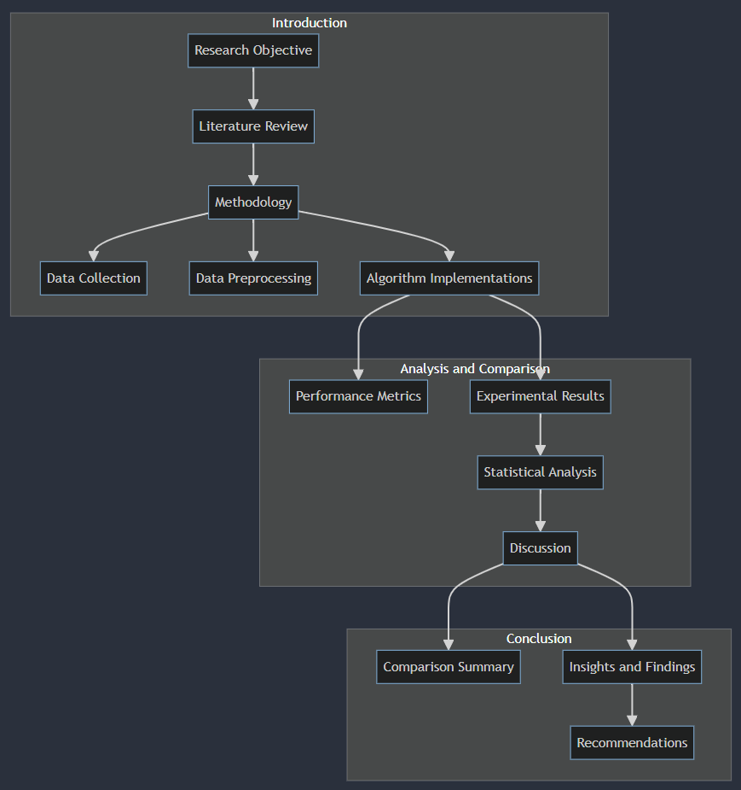
Working Model
Technical Diagram

Slide 14
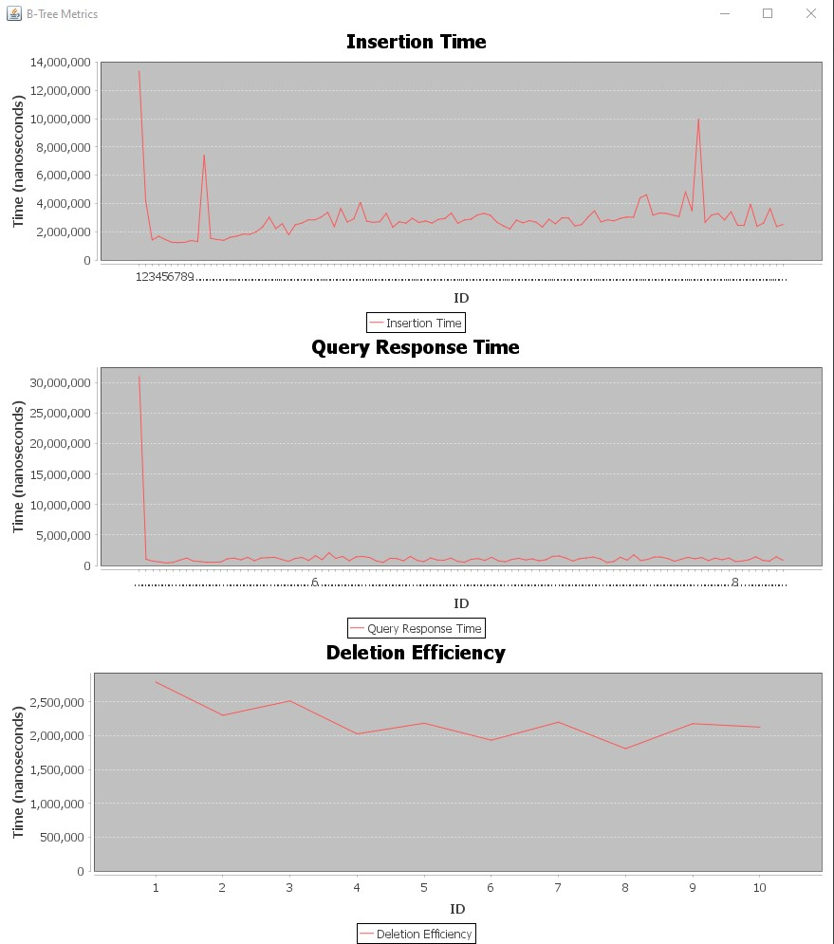
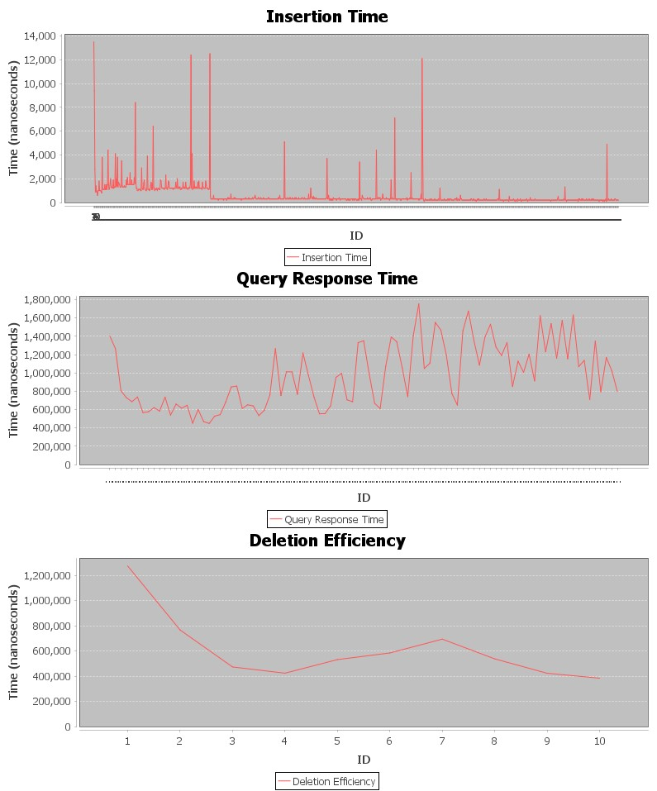
Results
Outcome Graphs
Implementing a B-Tree with AVL optimization involves merging B-Tree and AVL tree features. This hybrid structure maintains balance through rotations, ensuring efficient search, insertion, and deletion operations. By combining B-Tree's storage efficiency with AVL's balance maintenance, it offers an optimal solution for managing large datasets.
B Tree without optimization
B Tree with AVL Optimization

Slide 15
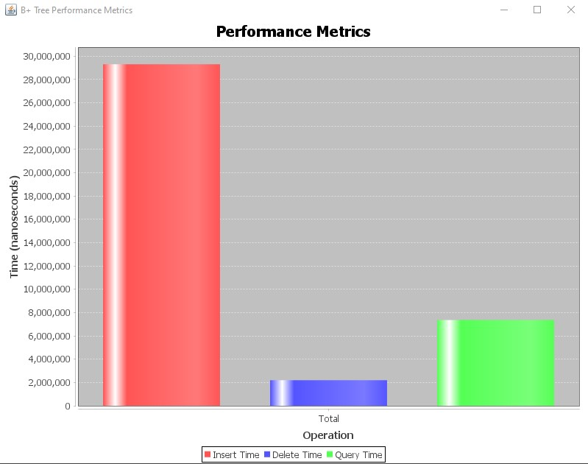
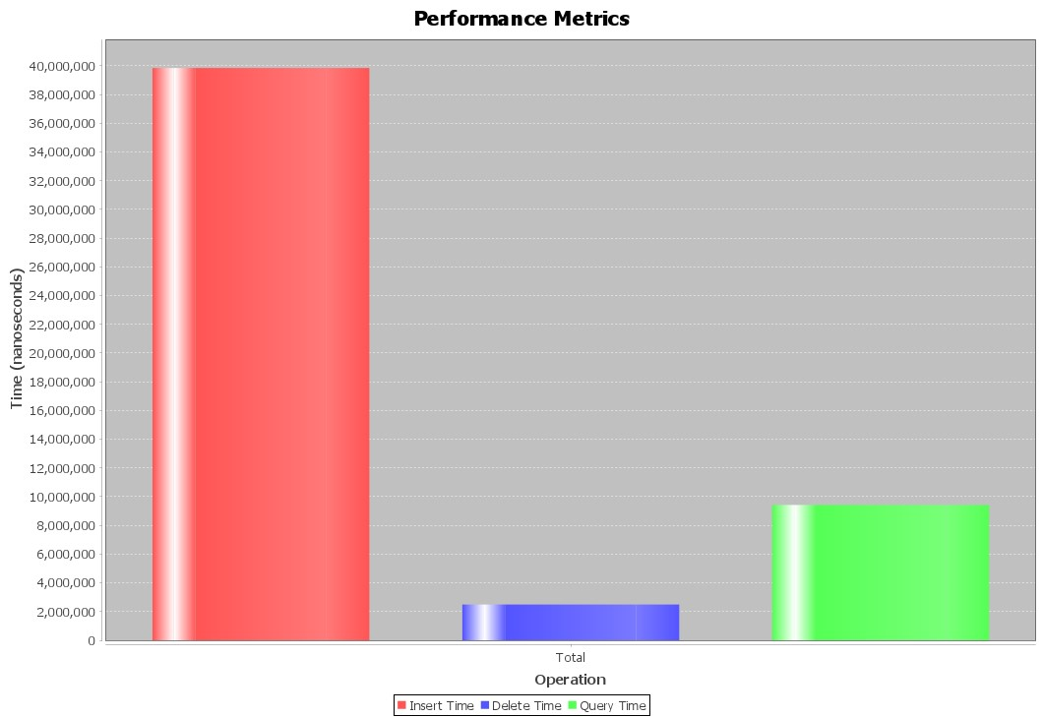
Results
Outcome Graphs
B+ Tree without optimization
B+ Tree with Caching Optimization
To optimize the B+ tree with caching, use smaller node sizes for better cache utilization. Organize data within nodes efficiently and prioritize frequent accesses. Predict future needs and prefetch relevant nodes. Leverage access patterns and data distribution to dynamically adjust optimization strategies.

Slide 16
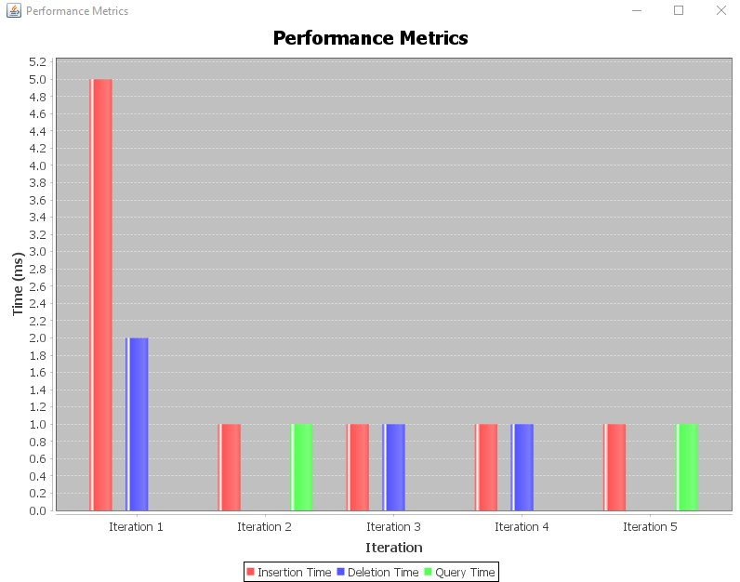
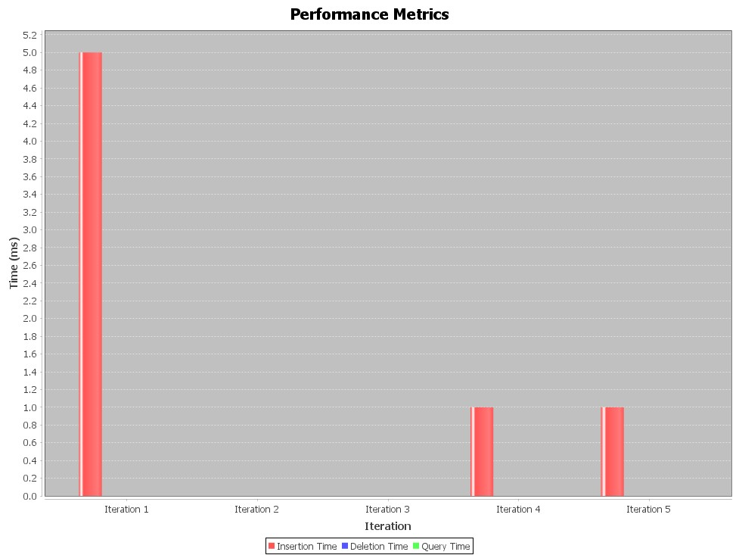
Results
Outcome Graphs
Hash Indexing with Batch processing optimization
HashMap Indexing without optimization

Slide 17
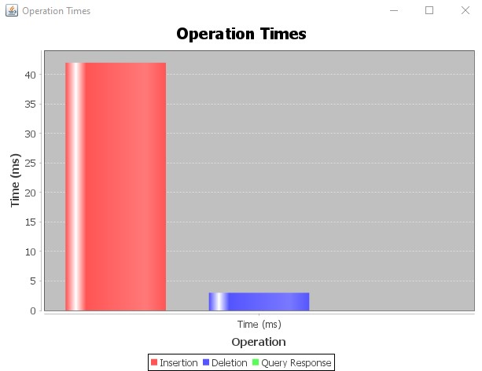
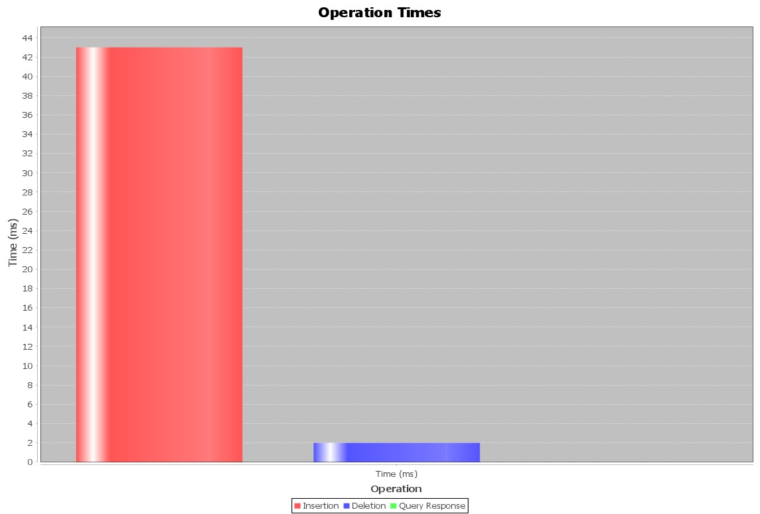
Results
Outcome Graphs
Bitmap indexing without optimization
Bitmap indexing with StringBuilder optimization

Slide 18
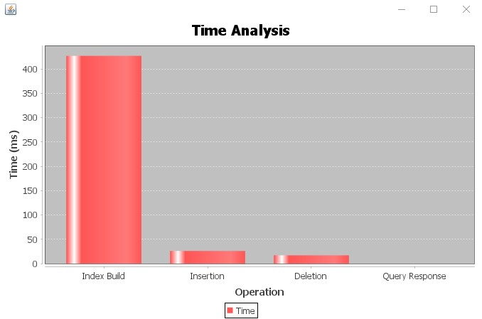
Results
Outcome Graphs
Inverted Indexing without optimization
Inverted indexing with Thread pooling optimization

Slide 19
Reference
List of cited papers:
Kim, H., Lee, H., & Park, K. (2002). The case for a hybrid B+-tree and bitmap index structure. In Proceedings of the 28th international conference on Very Large Data Bases (VLDB '02).
Haas, L. M., Naughton, J. F., Seshadri, S., & Stokes, L. (1994). Extensible hashing: A fast access method for dynamic files. ACM Transactions on Database Systems, 19(3), 461-494.
Wu, K., Otoo, E. J., & Shoshani, A. (2007). Optimizing bitmap indices with efficient compression. In Proceedings of the 2007 ACM SIGMOD international conference on Management of data (SIGMOD '07).
Mantas, A., & Psarakis, S. (2016). A survey of modern bitmap index compression techniques. ACM Computing Surveys, 48(4), 1-41.
Beckmann, N., Kriegel, H. P., Schneider, R., & Seeger, B. (1990). The R*-tree: An efficient and robust access method for points and rectangles. In Proceedings of the 1990 ACM SIGMOD international conference on Management of data (SIGMOD '90).
Hjaltason, G. R., & Samet, H. (2003). Speeding up the R*-tree: A case for premature termination. In Proceedings of the 2003 ACM SIGMOD international conference on Management of data (SIGMOD '03).
Graefe, G. (2014). A survey of cache-conscious algorithms and data structures. ACM Computing Surveys, 45(3), 1-54.

Slide 20
Reference
List of cited papers:
Culpepper, J. S., & Moffat, A. (2010). Inverted indexes for text search engines. ACM Computing Surveys, 42(2), 1-38.
Tian, C., Luo, Y., Yang, S., & Guo, M. (2015). A detailed survey on LSM-tree. In Proceedings of the 2015 ACM SIGMOD international conference on Management of data (SIGMOD '15).
Pavlo, A., Angulo, P., Arulraj, J., Lin, H., Lin, J., Menon, P., ... & Zhang, L. (2017). Self-driving database management systems. CIDR.
Kraska, T., Beutel, A., Chi, E. H., Dean, J., Diakonikolas, I., Fekete, J., ... & Sugihara, G. (2018). The case for learned index structures. Proceedings of the VLDB Endowment, 11(13), 2013-2026

Slide 21
Thank You

